Slide 1
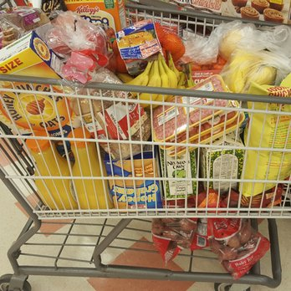
Store Market Report Based On Market Basket Analysis
N130954
Project Guide-K.K.SINGH

Slide 2
Contents
Motivation
Introduction
Objective
Definitions and Terminology
Algorithm
Example
Input
Output
Advantages
Disadvantages
Conclusion
References

Slide 3
Motivation
Today, the large amount of data is being maintained in the databases in various fields like markets, banking sector, medical field etc.
But it is not necessary that the whole information is useful for the user. That is why, it is very important to extract the useful information from large amount of data.
This process of extracting useful data is known as data mining.
Market Basket Analysis is one of the data mining technique.
Market basket analysis is also known as association rule mining. It helps the marketing analyst to understand the behavior of customers e.g. which products are being bought together.

Slide 4
Introduction
Market Basket Analysis (Association Analysis) is a mathematical modeling technique based upon the theory that if you buy a certain group of items, you are likely to buy another group of items.
A large number of people use to visit shopping malls and shopping centers.
Massive amounts of data continuously being collected and stored as transactions.
The availability of detailed information on customer transactions has led to the development of techniques that automatically look for associations between items that are stored in the database.
Those collected data can be useful from the business prospective such as

Slide 5
Objective
To find frequently purchased item sets from large transactional database.
The primary objective of Market Basket Analysis is to improve the effectiveness of marketing and sales.

Slide 6
Definitions And Terminology
Transaction: is a set of items (Itemset).
Confidence : It is the measure of uncertainty or trust worthiness associated with each discovered pattern.
Support : It is the measure of how often the collection of items in an association occur together as percentage of all transactions
Frequent itemset : If an itemset satisfies minimum support , then it is a frequent itemset.
Strong Association rules: Rules that satisfy both a minimum support threshold and a minimum confidence threshold.
In Association rule mining, we first find all frequent item sets and then generate strong association rules from the frequent item sets.

Slide 7
Algorithm
Apriori algorithm is the most established algorithm for finding frequent item sets mining.
Apriori algorithm follows the antimonotone property.
We use these frequent item sets to generate association rules.
An Apriori algorithm is used to find association rules between different product categories.

Slide 8
Market Basket Analysis is done separately to find associations between products that are browsed, products purchased online, and products purchased in-store.
Browsing behavior data is aggregated to get all the products purchased by a customer and all the products browsed by a customer.
The Apriori algorithm is then applied on the aggregated data to find the association between different product categories for the products that are purchased and the products that are browsed.

Slide 9
Step 1:
Scan the transaction database to get the support S of each 1-itemsets. And compare S with min _ sup ,and get a frequent 1- item set .
Step 3:
Scan the transaction database to get the support S of each candidate k –itemset in the final set . compare S with min _ sup , and get a set of frequent item sets Lk.
Step2:
Generate a candidate itemset of size k+1 from frequent itemset of size.(by using Fk-1 join Fk-1 method)
Step 4:
The candidate set -null
No
yes
Step 6:
For every non empty sets of S , generate the rules.
Step 5:
For each frequent item set 1,generate all non empty subsets of S.

Slide 10
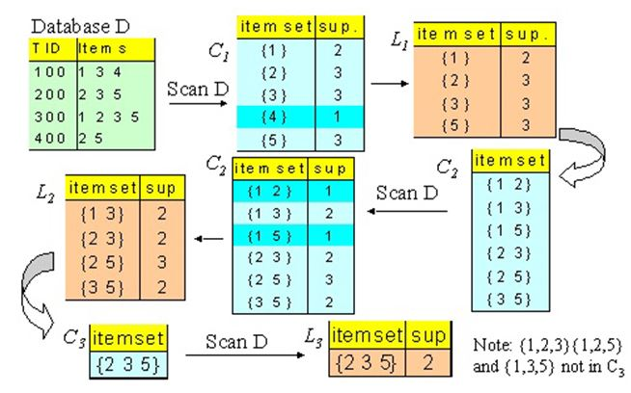

Slide 11
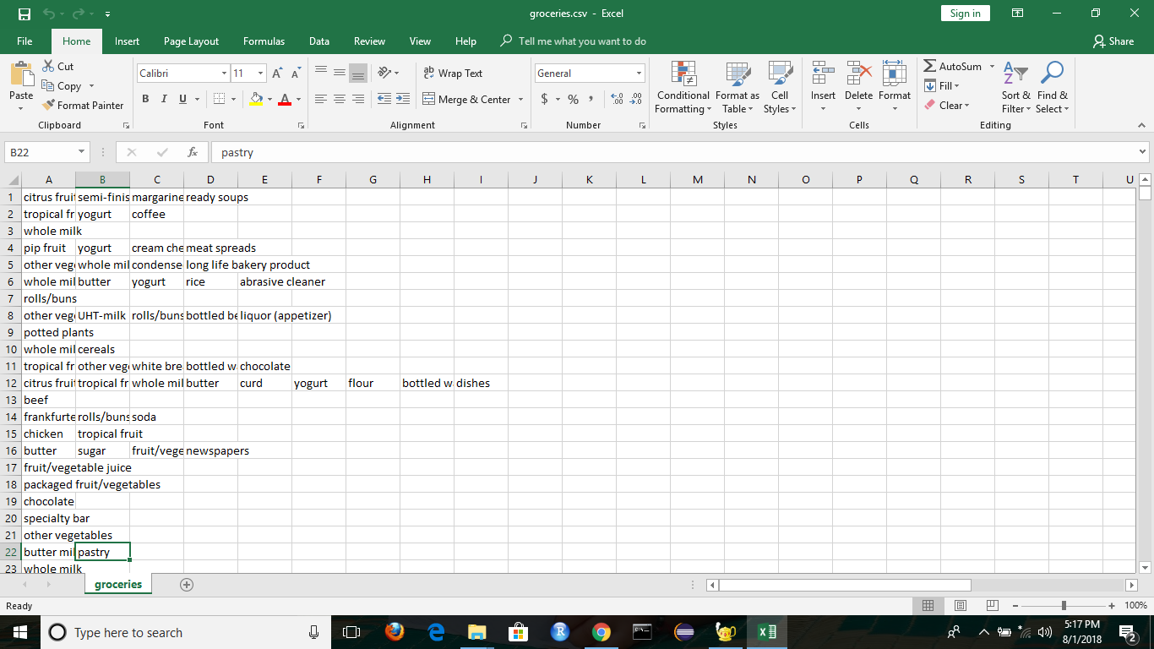
Input Given

Slide 12
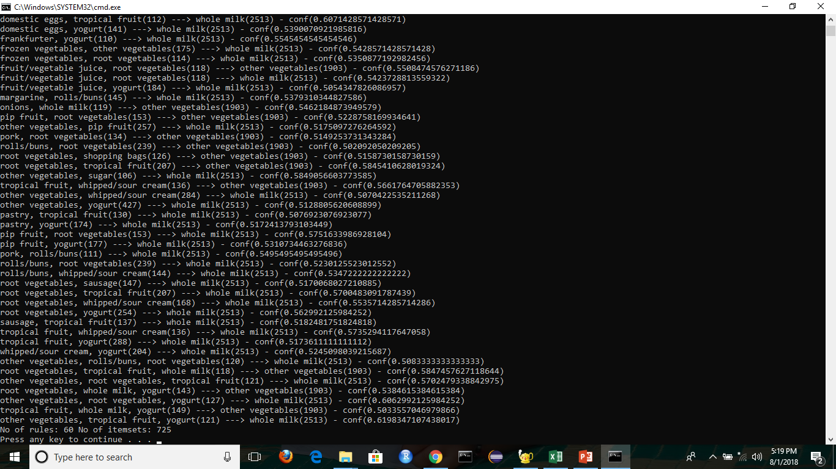
Output

Slide 13
Advantages
Apriori algorithm works well and will not cause any issue just because it considers A->B and B->A as same because this is an approach used for cross-selling the products based on the market based analysis.

Slide 14
Disadvantages
The primary limitation of apriori algorithm is the efficiency.
Apriori algorithm may become really slow especially when there are more candidates to analyze.

Slide 15
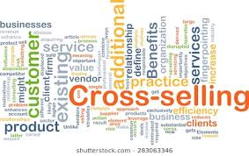
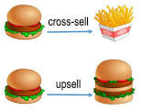
Applications
Cross selling of the items.

Slide 16
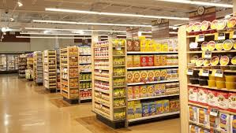
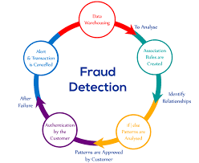
Proper Placement of items.
Fraud Detection.

Slide 17
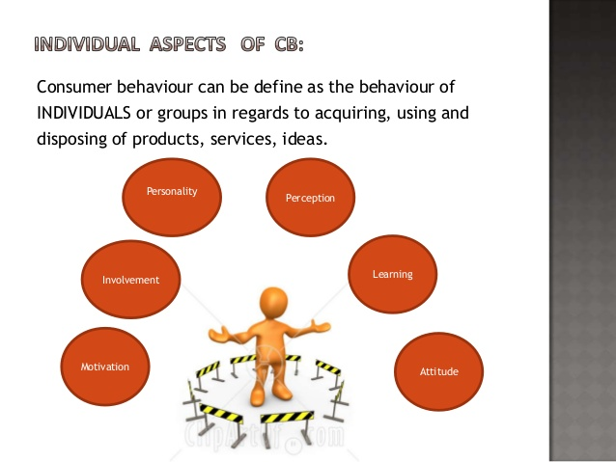
Customer behavior

Slide 18
Conclusion
It is an approach to association rule mining in multiple store environment.
I have shown how Market basket analysis using association rules works in determining the customer buying patterns.

Slide 19
References
Stack overflow
GitHub.com
pypi.python.org/pypi/pandas

Slide 20
Thank You

